Slide 1


Quantum Enhanced
Reinforcement Learning
Quantum Machine Learning course Seminar
Speaker: Simone Caldarella

Slide 2
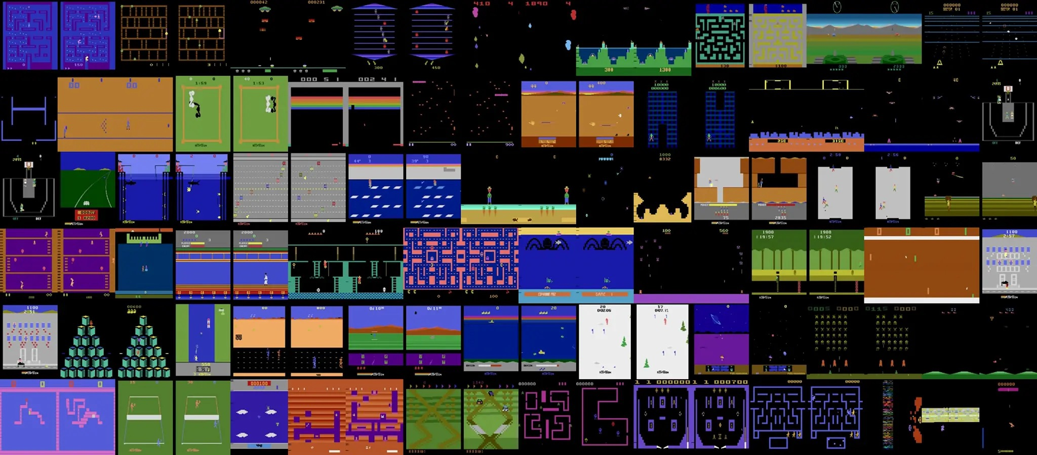
Motivation
Simone Caldarella | 223343

Slide 3

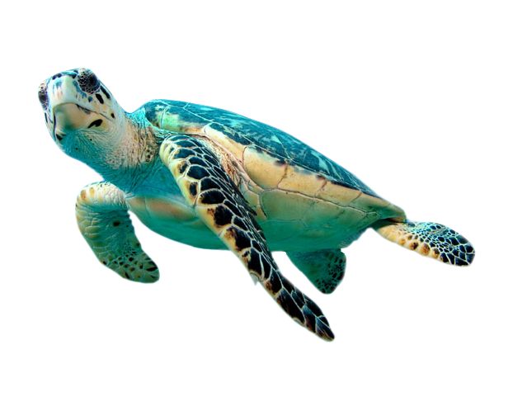
Motivation
Magic Box

Slide 4
Agenda
Reinforcement Learning
Introduction
Markov Decision Process
Value Function
Example
Quantum Computing
Introduction
Qubit and Superposition
Quantum Circuit
Grover Algorithm
Quantum Enhanced Reinforcement Learning
Setting
Implementation
Results

Slide 5
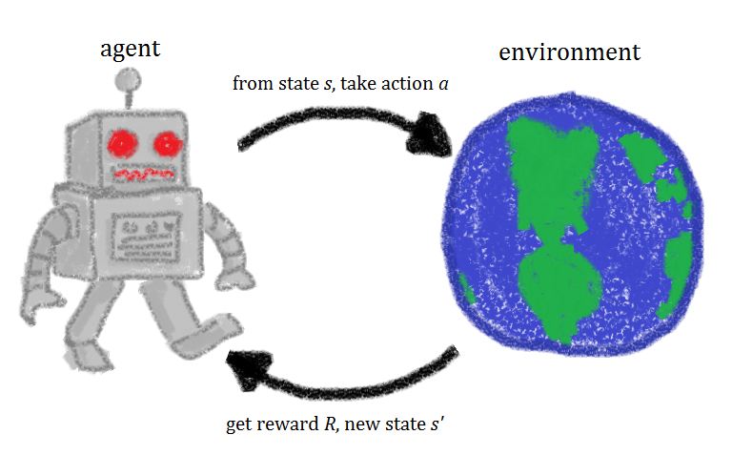
Reinforcement Learning

Slide 6
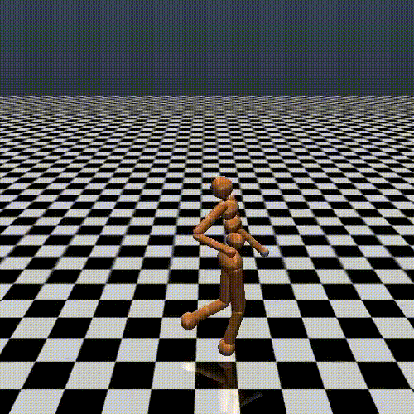
Introduction
What is Reinforcement Learning?
The process of learning what to do at a certain moment to maximize a numerical reward signal
Alternative Machine Learning Paradigm
Similarly to nature implies an evolution based on evaluative feedbacks provided by the environment
No right or wrongs choices, just better or worse ones
When is it used?
No explicit solution can be found
No absolute better action can be taken
Discover is required to be a part of the learning
Expensive labels, cheap rewards

Slide 7
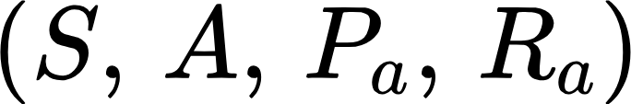


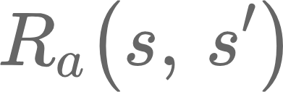

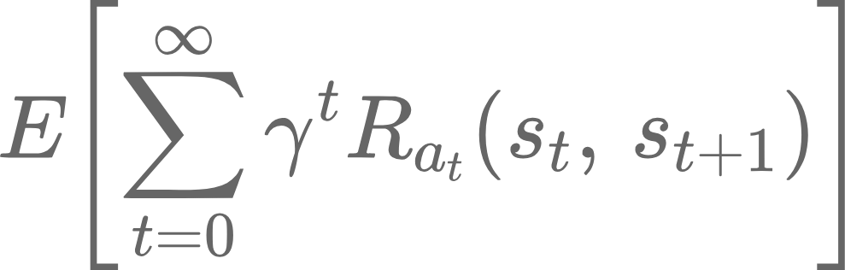
Markov Decision Process
A Markov Decision Process is a 4-dim tuple :
→ a finite state space
→ a finite actions space
→ transition probabilities
→ instant reward
The main goal is to find an optimal policy in the given environment, by maximizing the expected future rewards in a potentially infinite process:

Slide 8
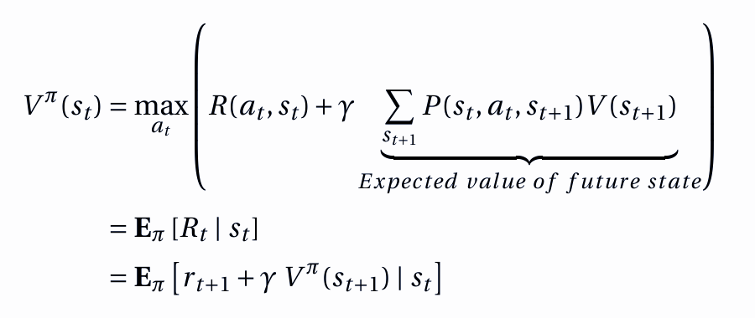
Value Function

Slide 9
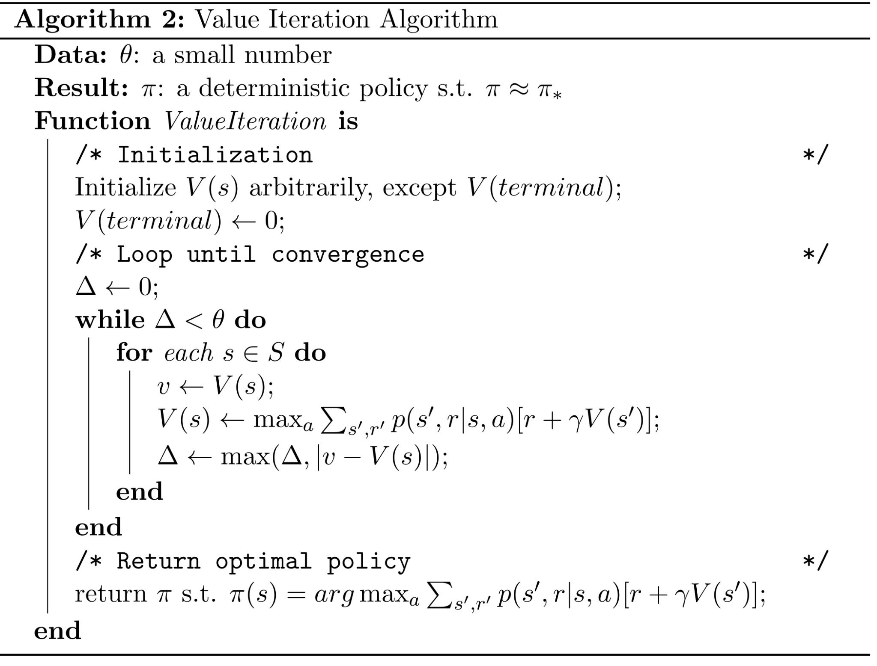
Value Function - Iteration

Slide 10
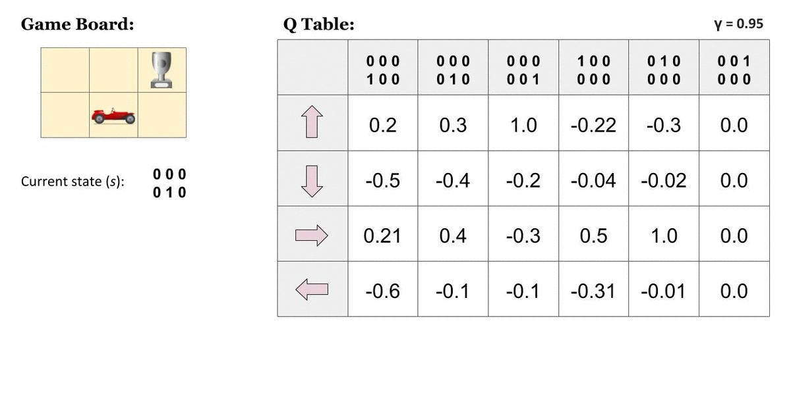
Example

Slide 11
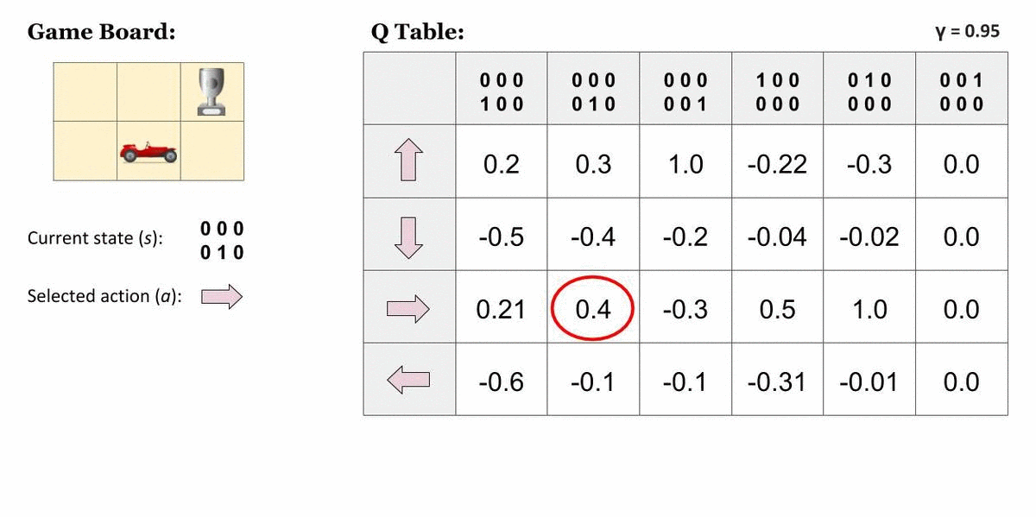
Example

Slide 12
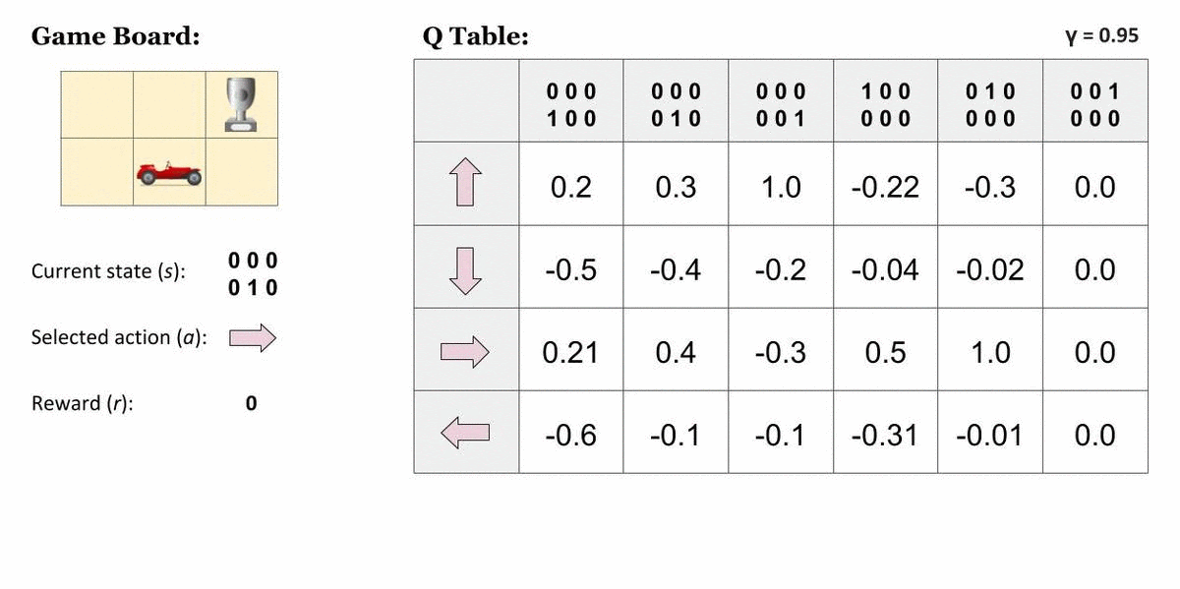
Example

Slide 13
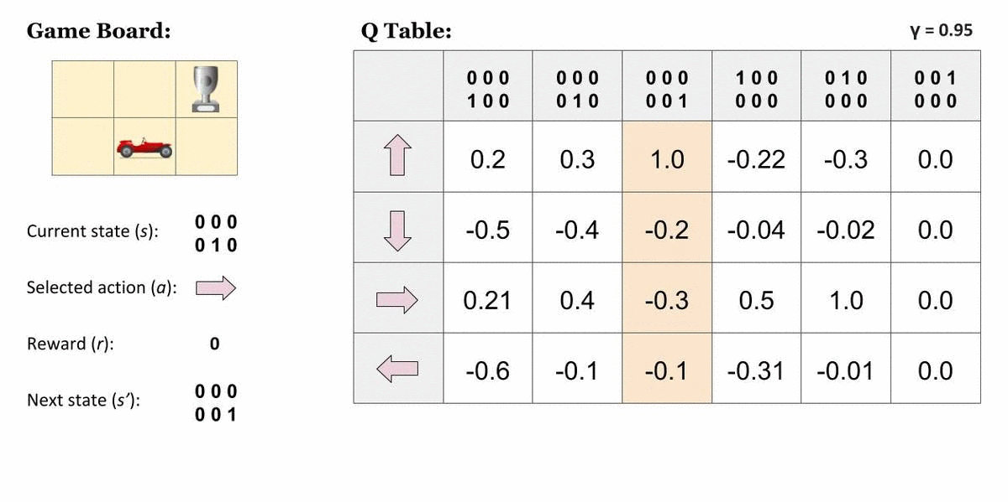
Example

Slide 14
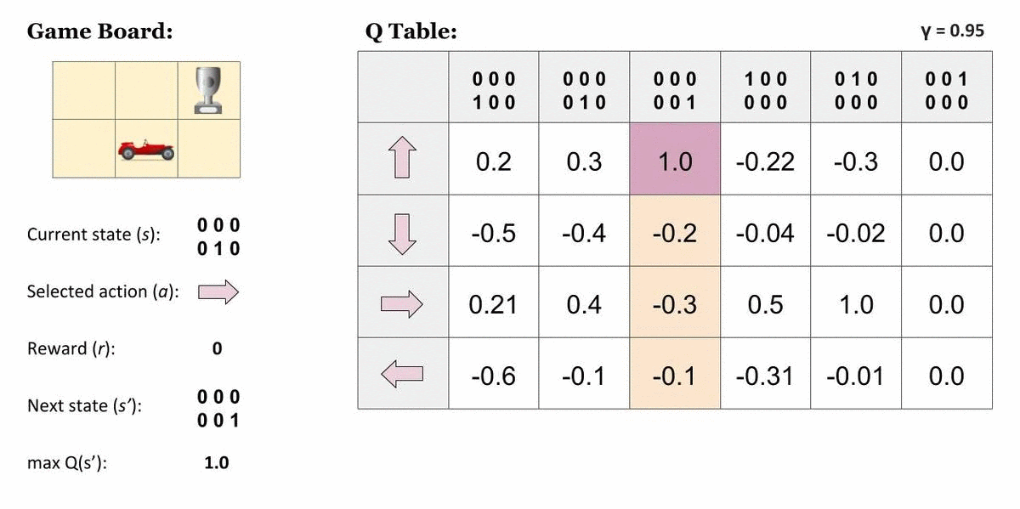
Example

Slide 15
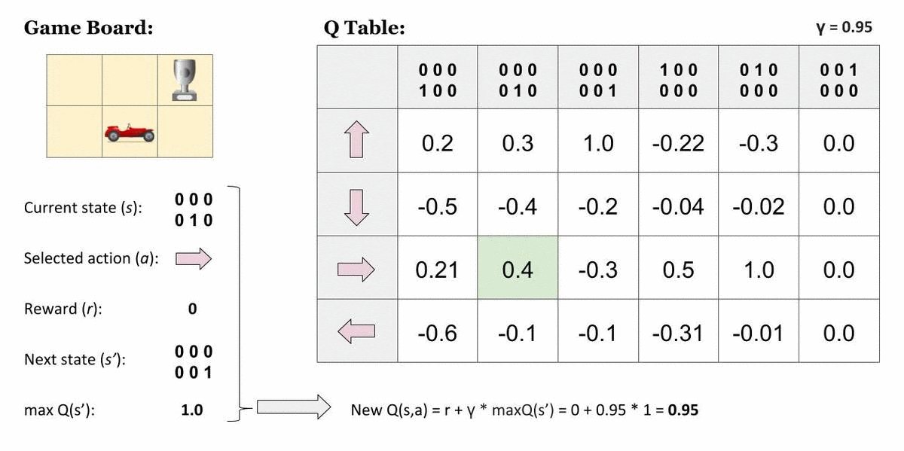
Example

Slide 16
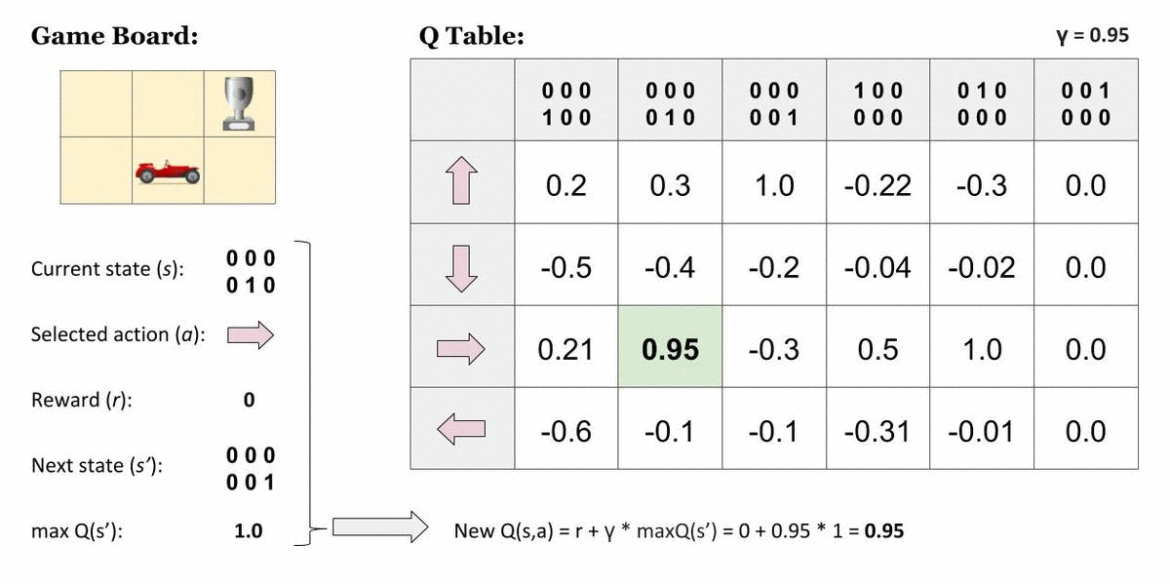
Example

Slide 17
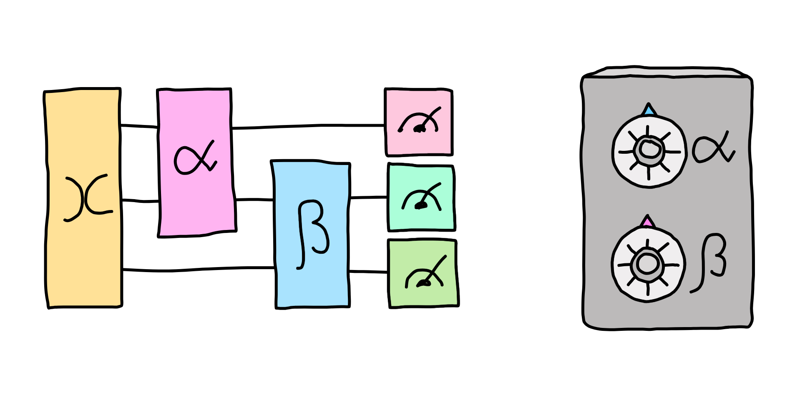
Quantum Computing

Slide 18
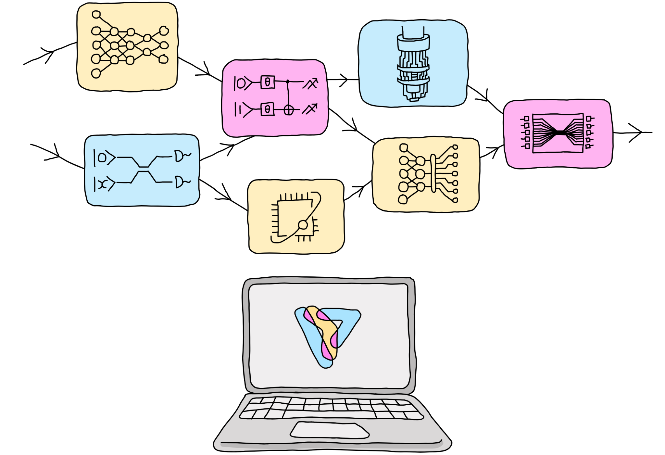
Introduction
Quantum computing expands classical computers' capabilities by harnessing quantum properties in the physical world
Leveraging quantum properties to speed-up classical algorithms
Main challenges are scalability and fault tolerance

Slide 19
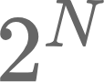
Qubits and Superposition
Qubit vs Cbit
Bit (Cbit) is just a discrete binary representation
Given N bit we can represent different states
Qubit can embed the same number of states, however thanks to the superposition of states, all of these states exists at the same time and can be processed together
Superposition
Fundamental property of quantum mechanics for which multiple states of a particle exists together with a degree of probability
Quantum Operations on superposition are performed only on quantum state→ when the state is observed it collapses into a single state and superposition exists no more

Slide 20
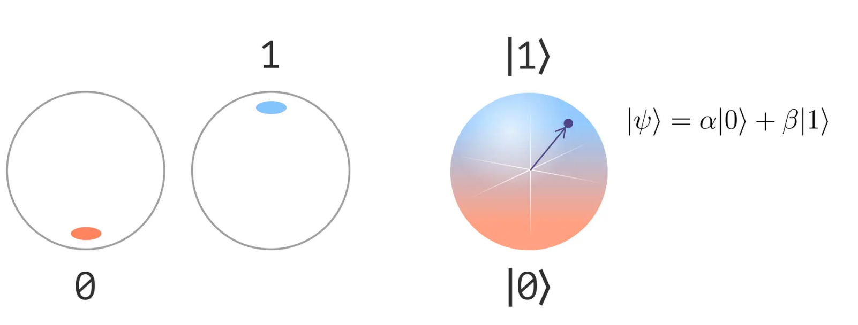
Qubits and Superposition

Slide 21
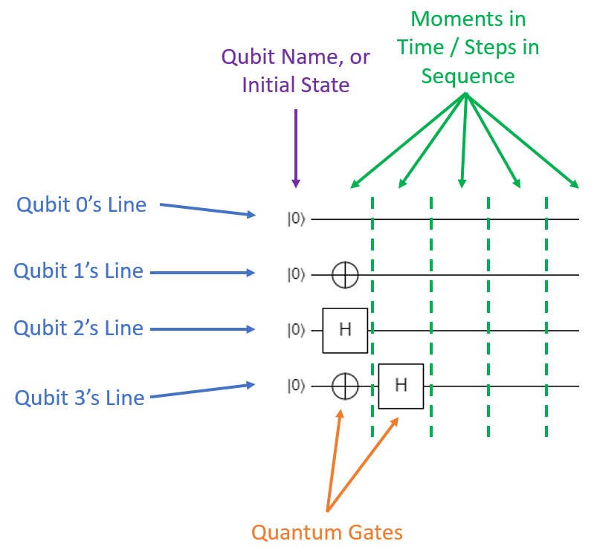
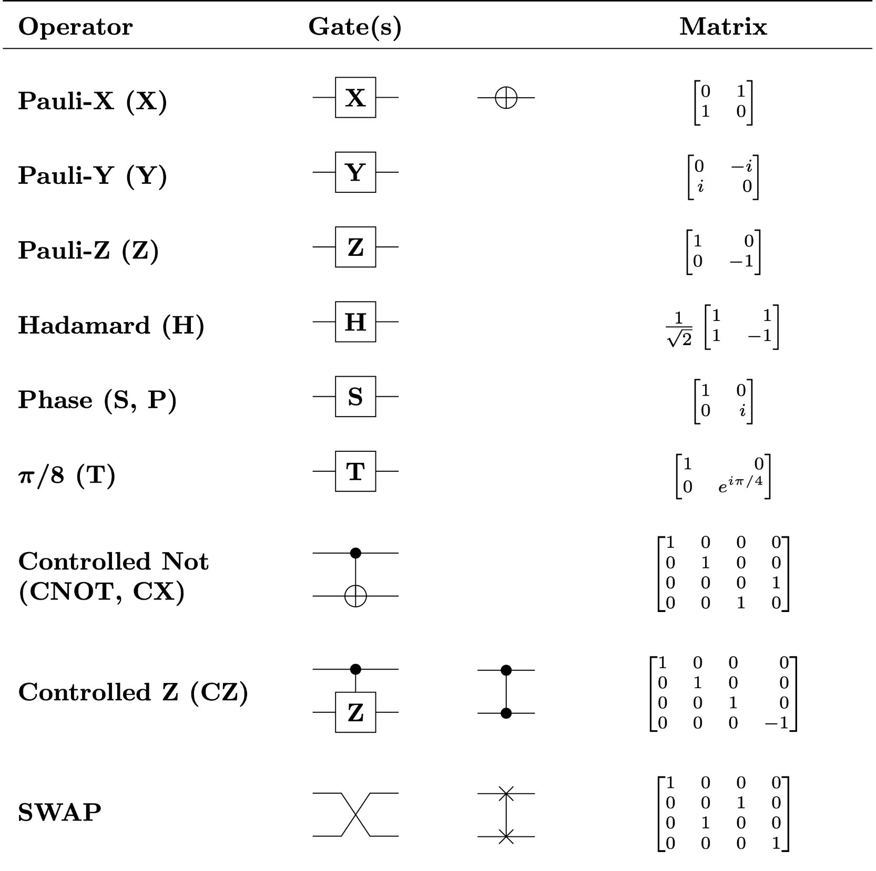
Quantum Circuit

Slide 22
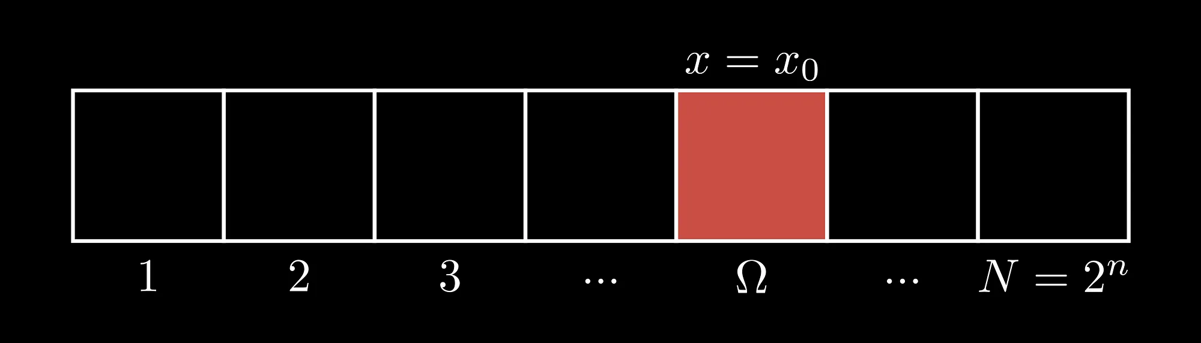
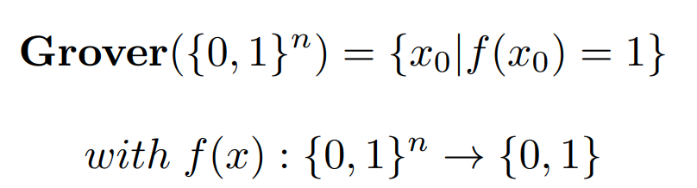
Grover Algorithm - Problem Statement
Given an unsorted database of N items, how can we efficiently find a specific item with only a few queries to the database?

Slide 23
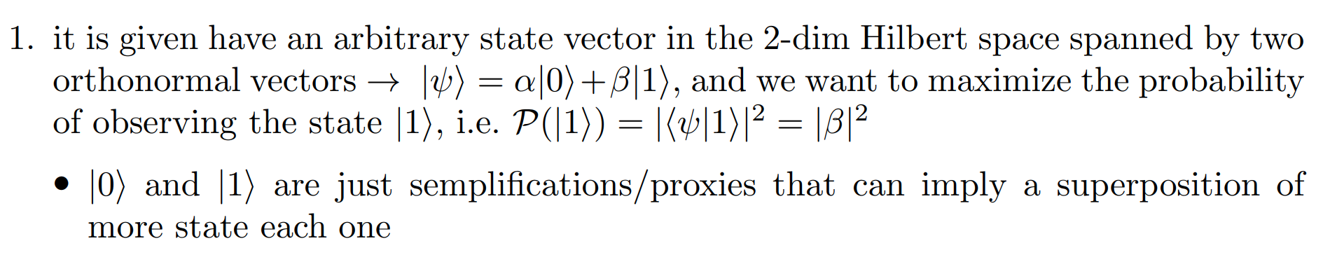
Grover Algorithm - Problem Statement

Slide 24
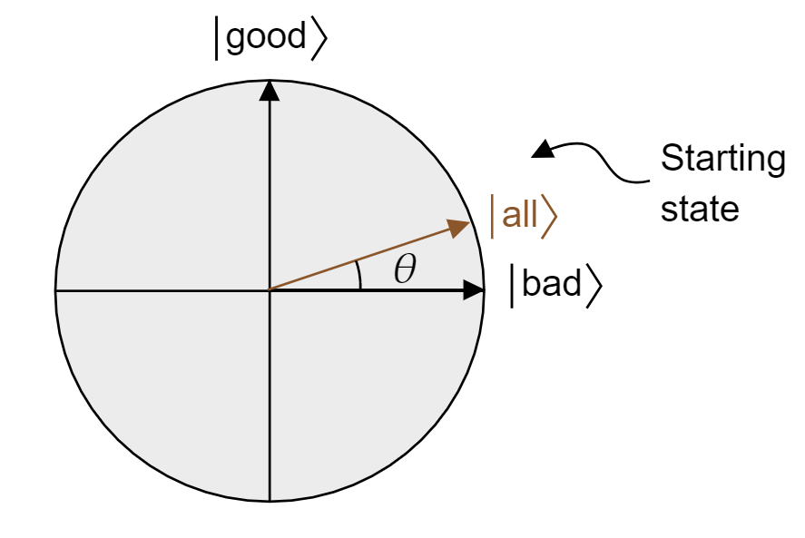
Grover Algorithm - Problem Statement

Slide 25
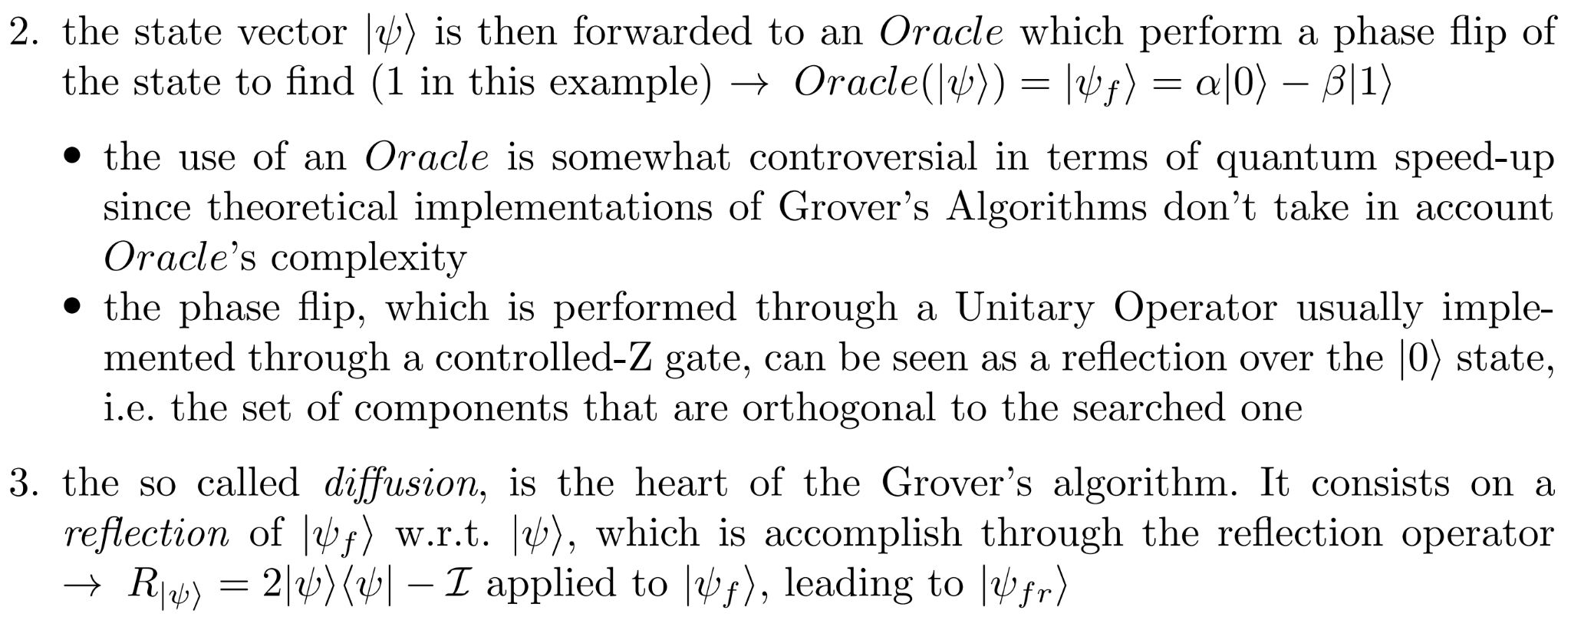
Grover Algorithm - Grover Iteration

Slide 26
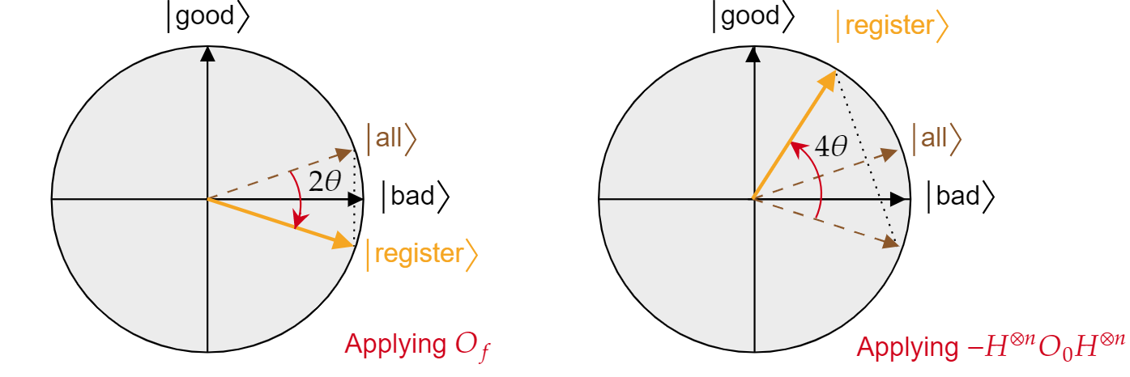
Grover Algorithm - Grover Iteration
2. Oracle
3. Diffusion

Slide 27
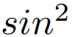
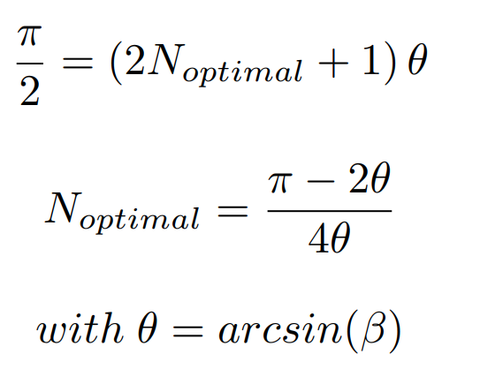
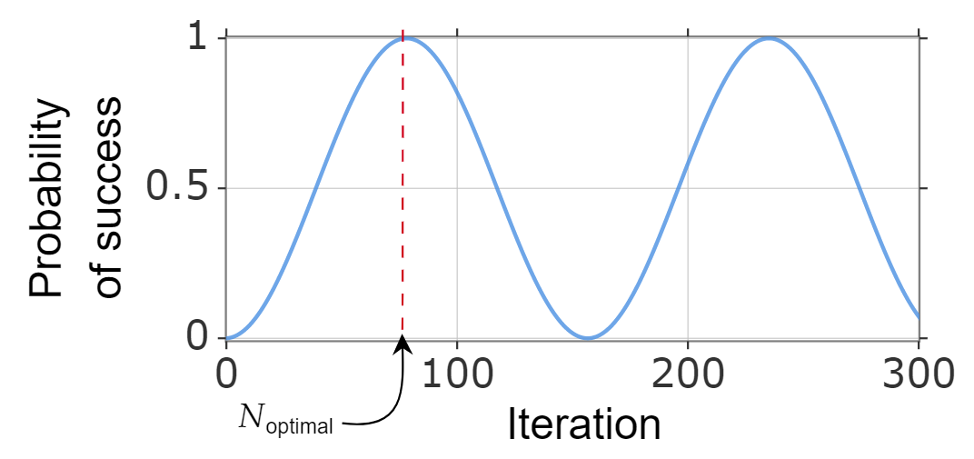
Grover Algorithm - Non Convergence
Since the probability of winning state evolve as a it doesn’t converge to an optimal solution

Slide 28
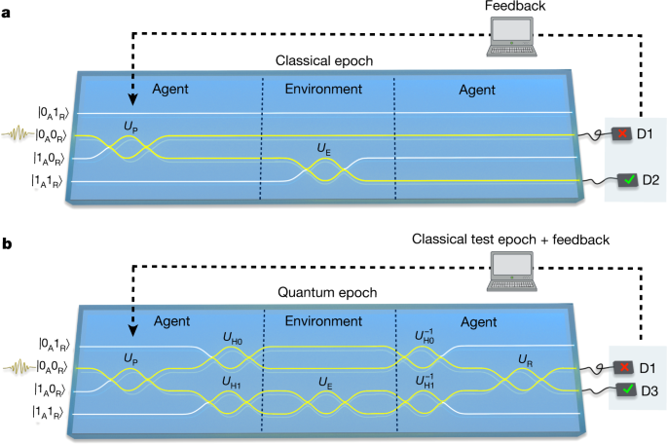
Quantum Enhanced Reinforcement Learning

Slide 29
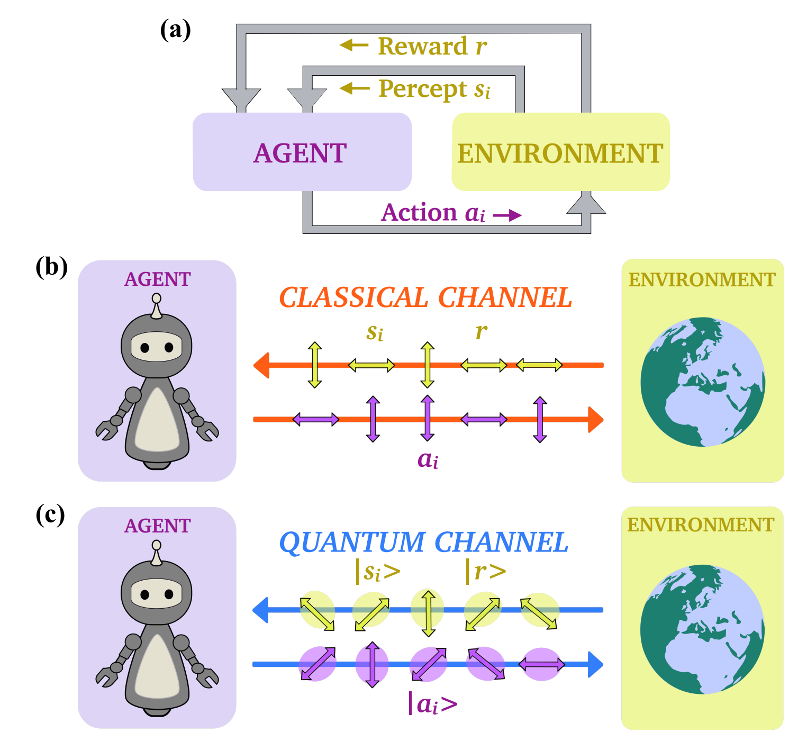
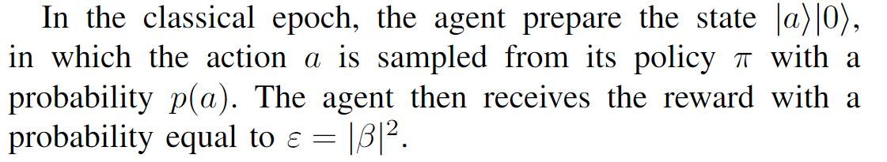
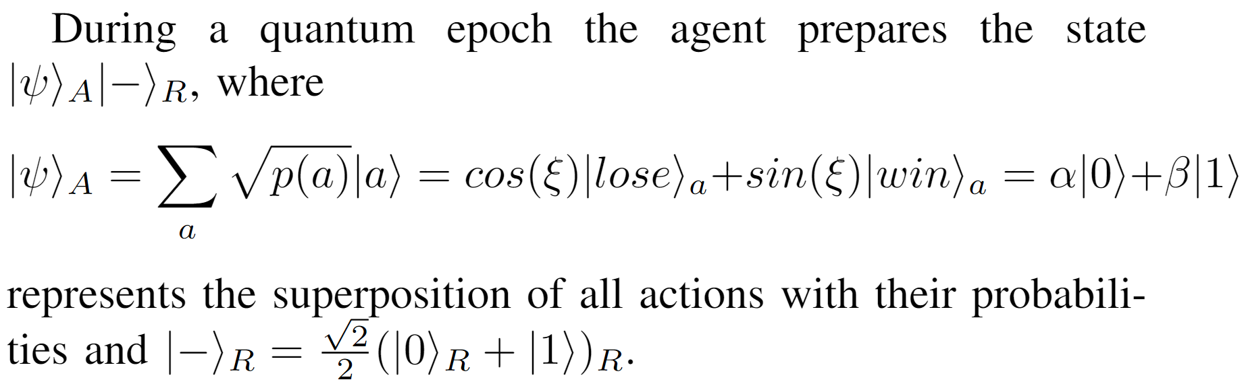
Setting

Slide 30
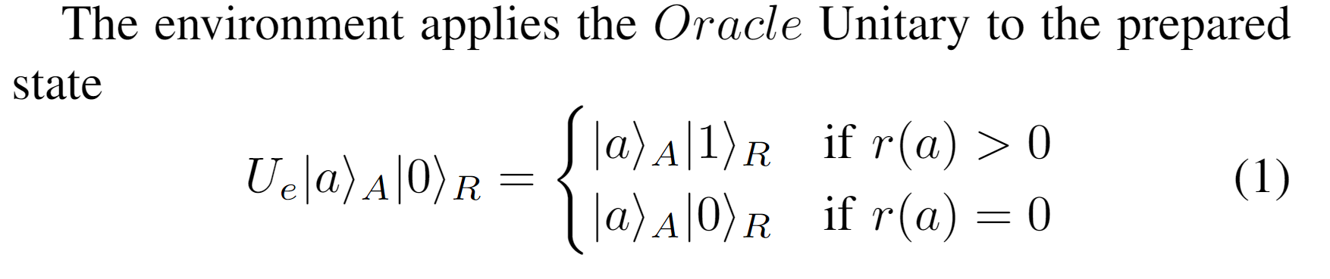
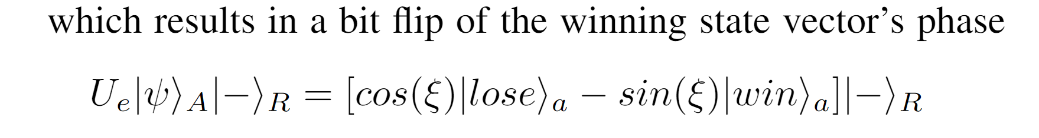
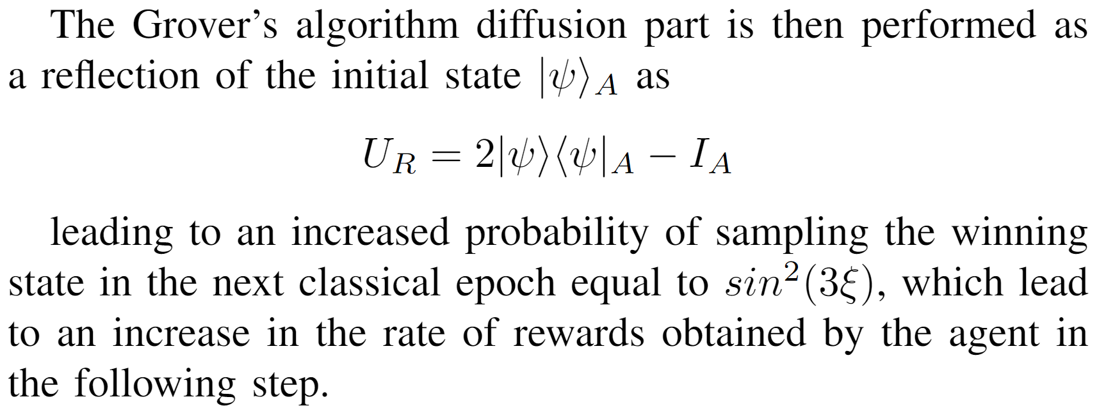
Setting

Slide 31
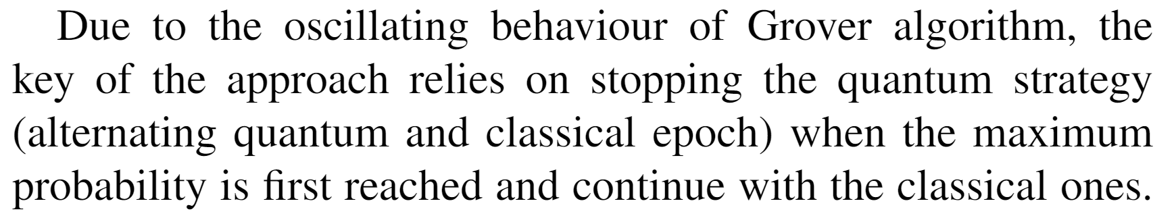
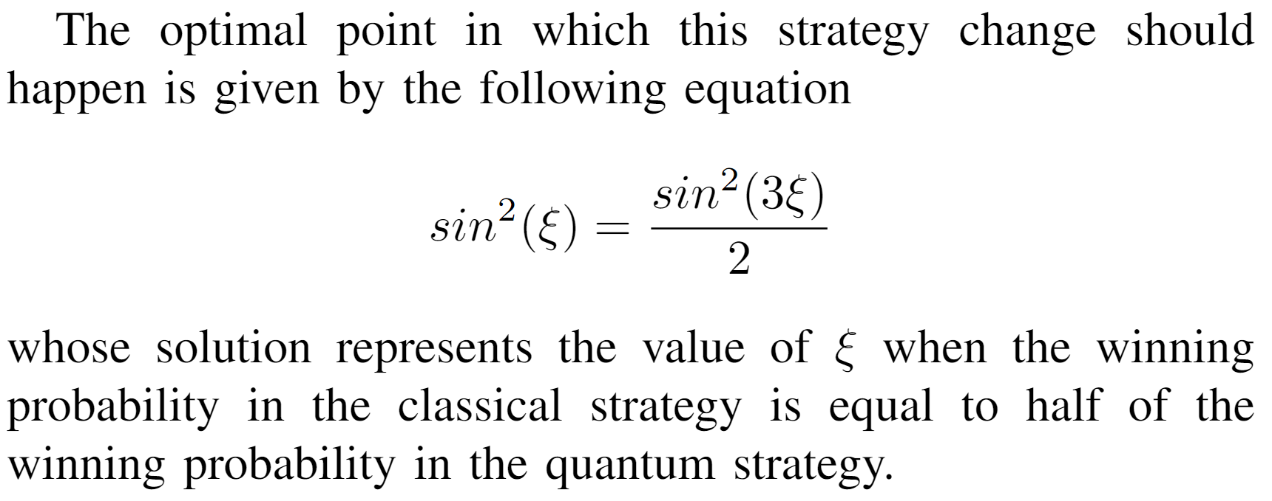
Setting

Slide 32
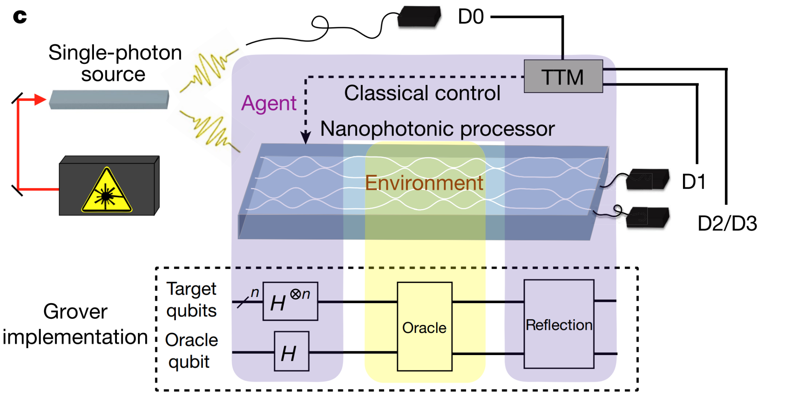
Setting

Slide 33
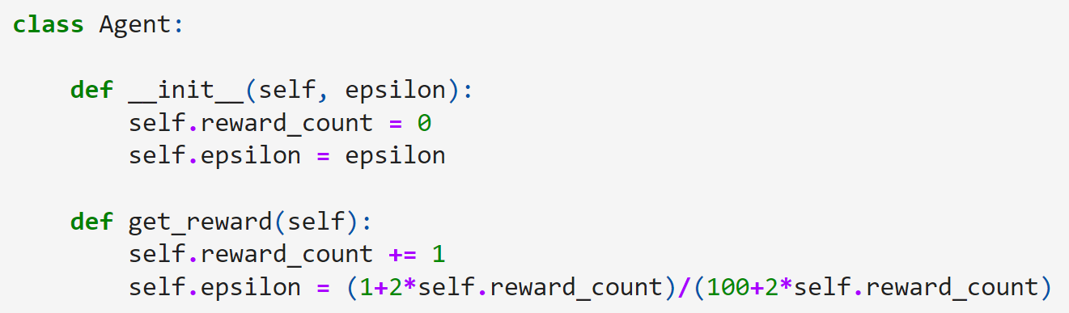
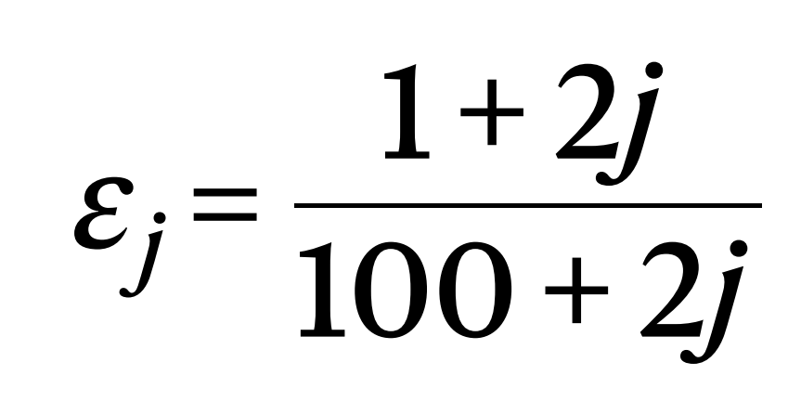
Implementation - Agent

Slide 34
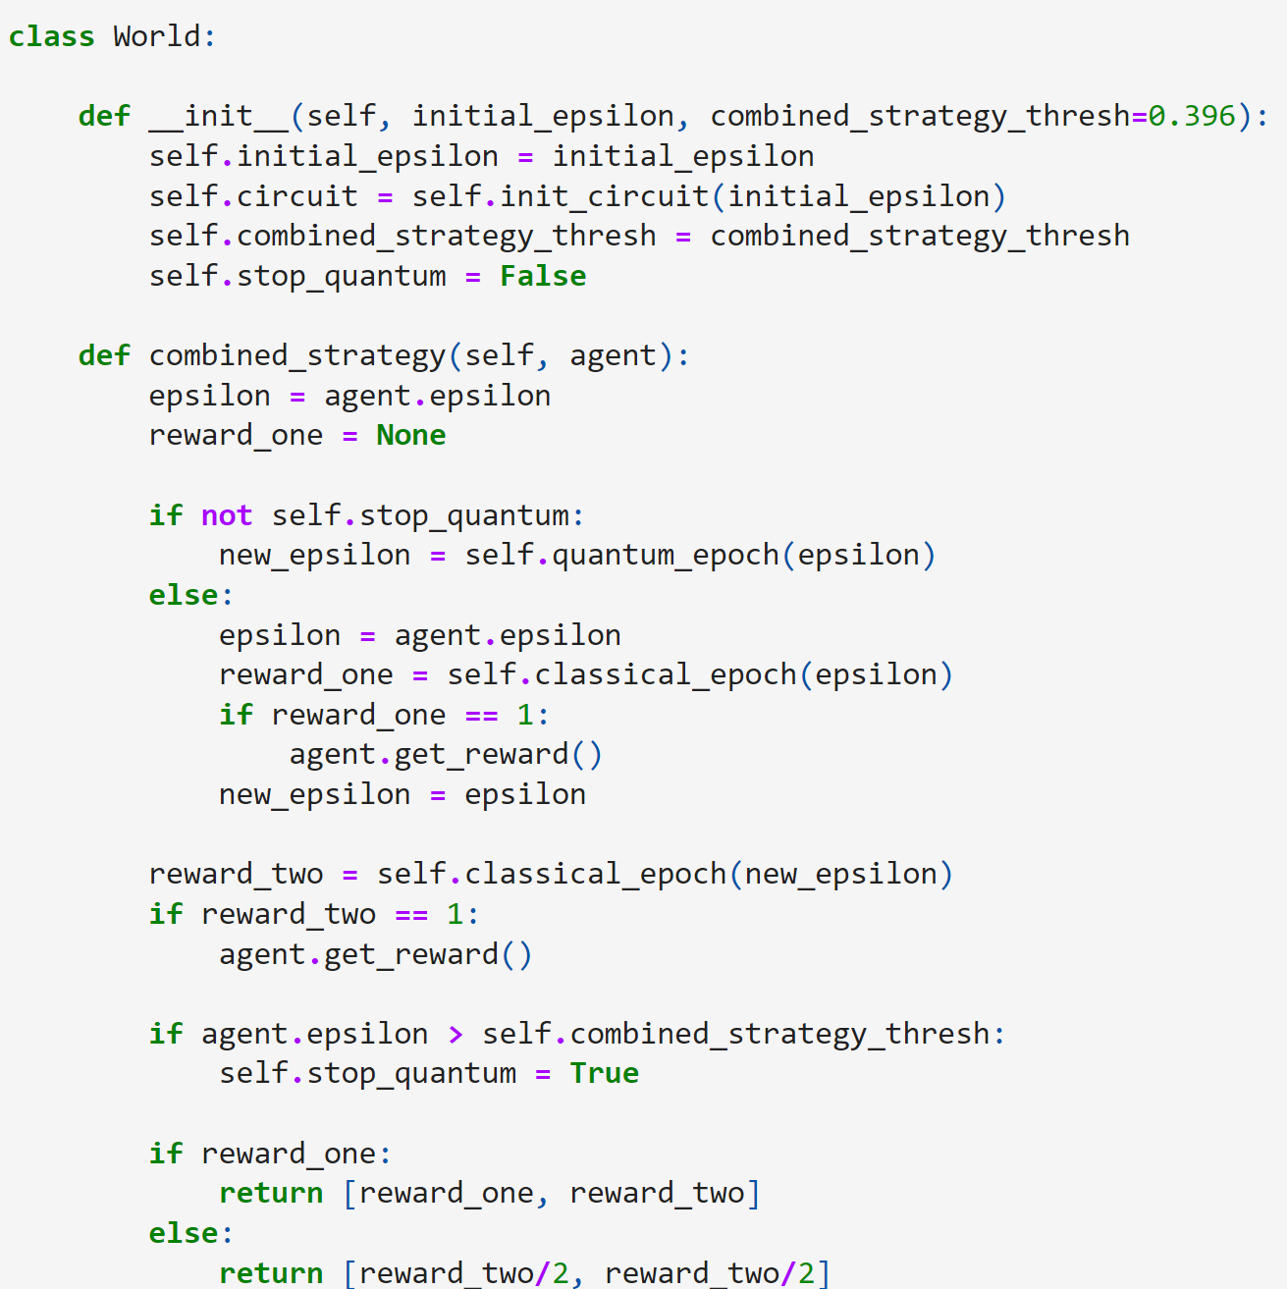
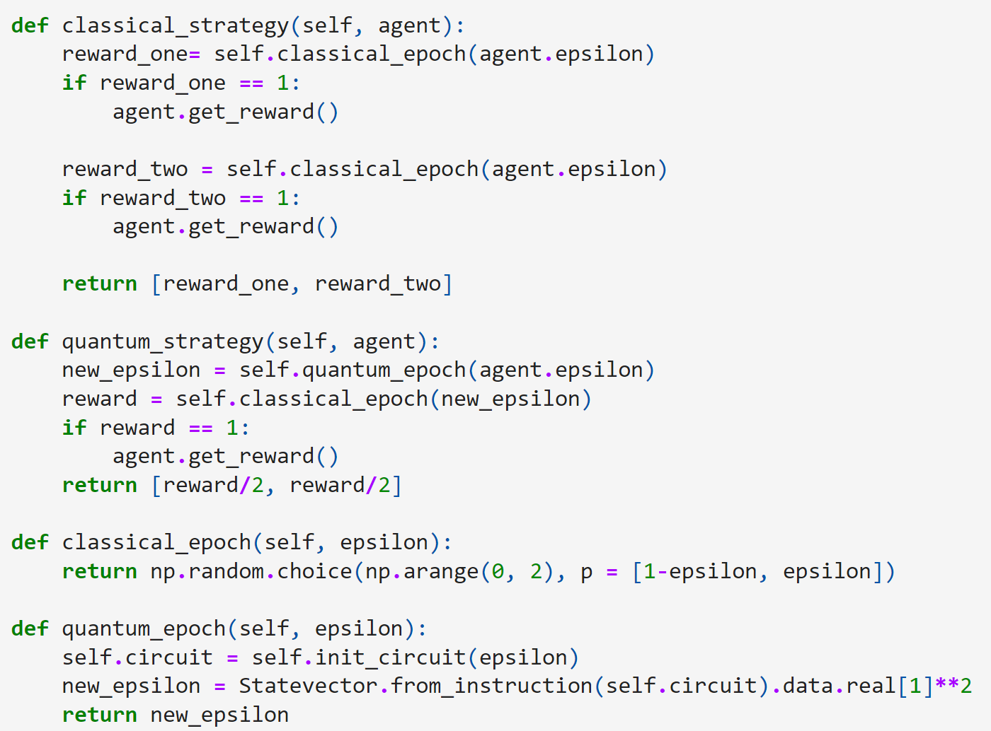
Implementation - World

Slide 35
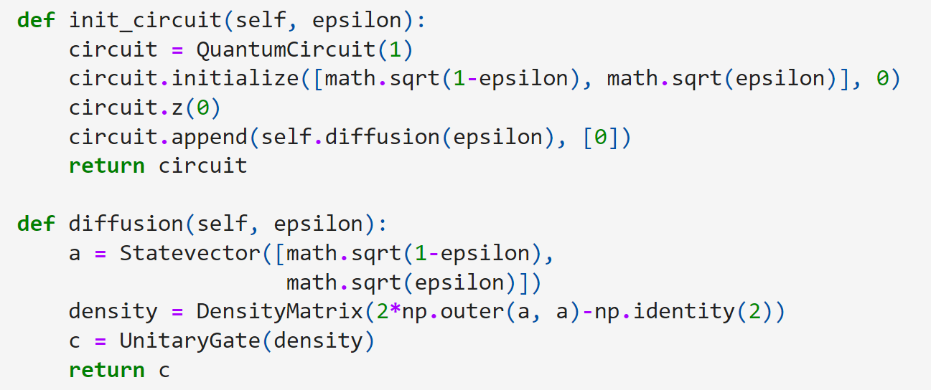
Implementation - World

Slide 36
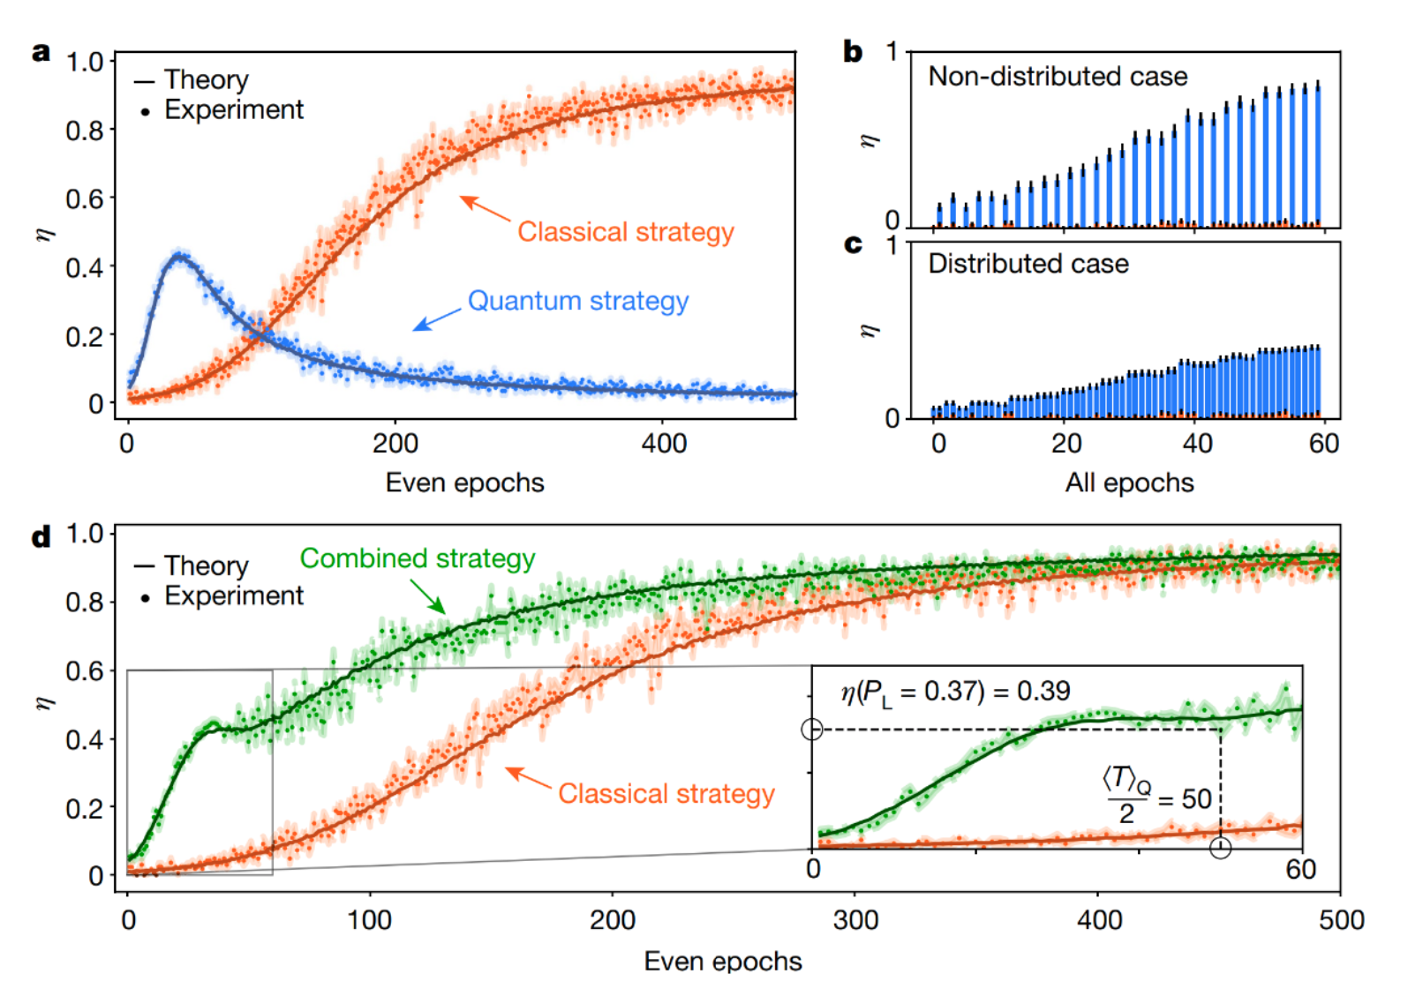
Results - Saggio et al.

Slide 37
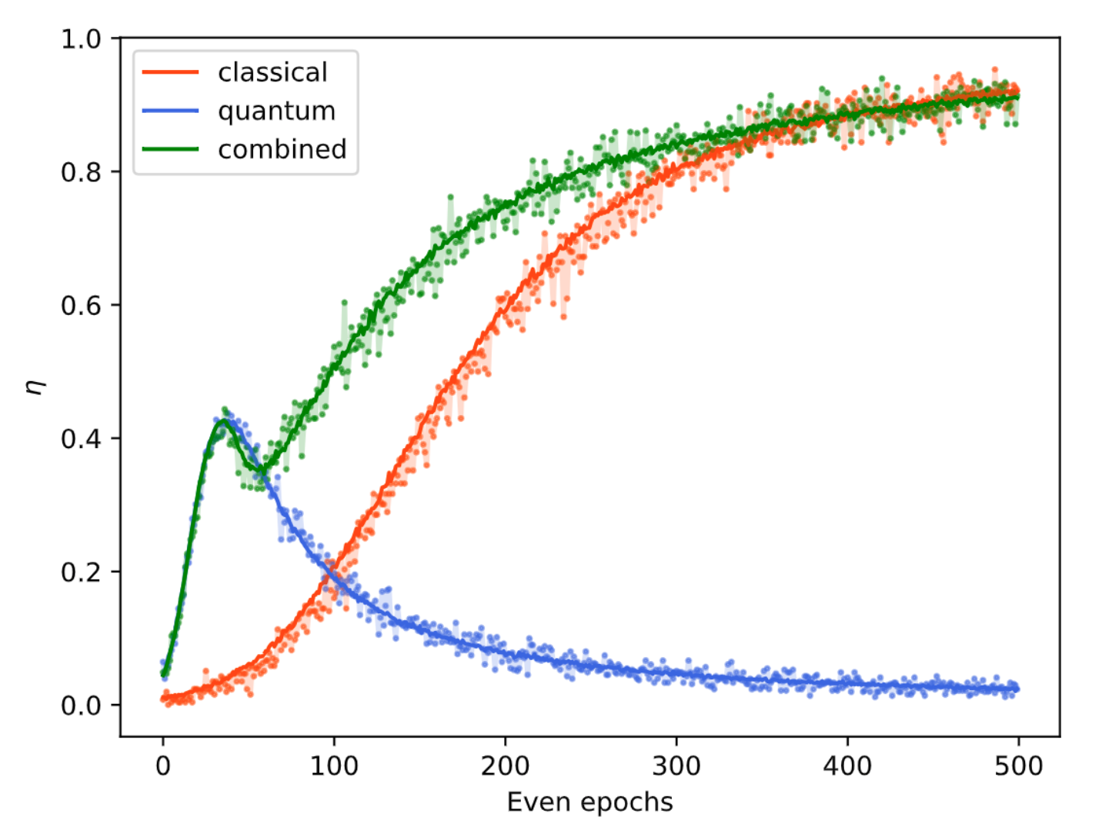
Results - Caldarella

Slide 38
Thank you!
Questions?

Slide 39
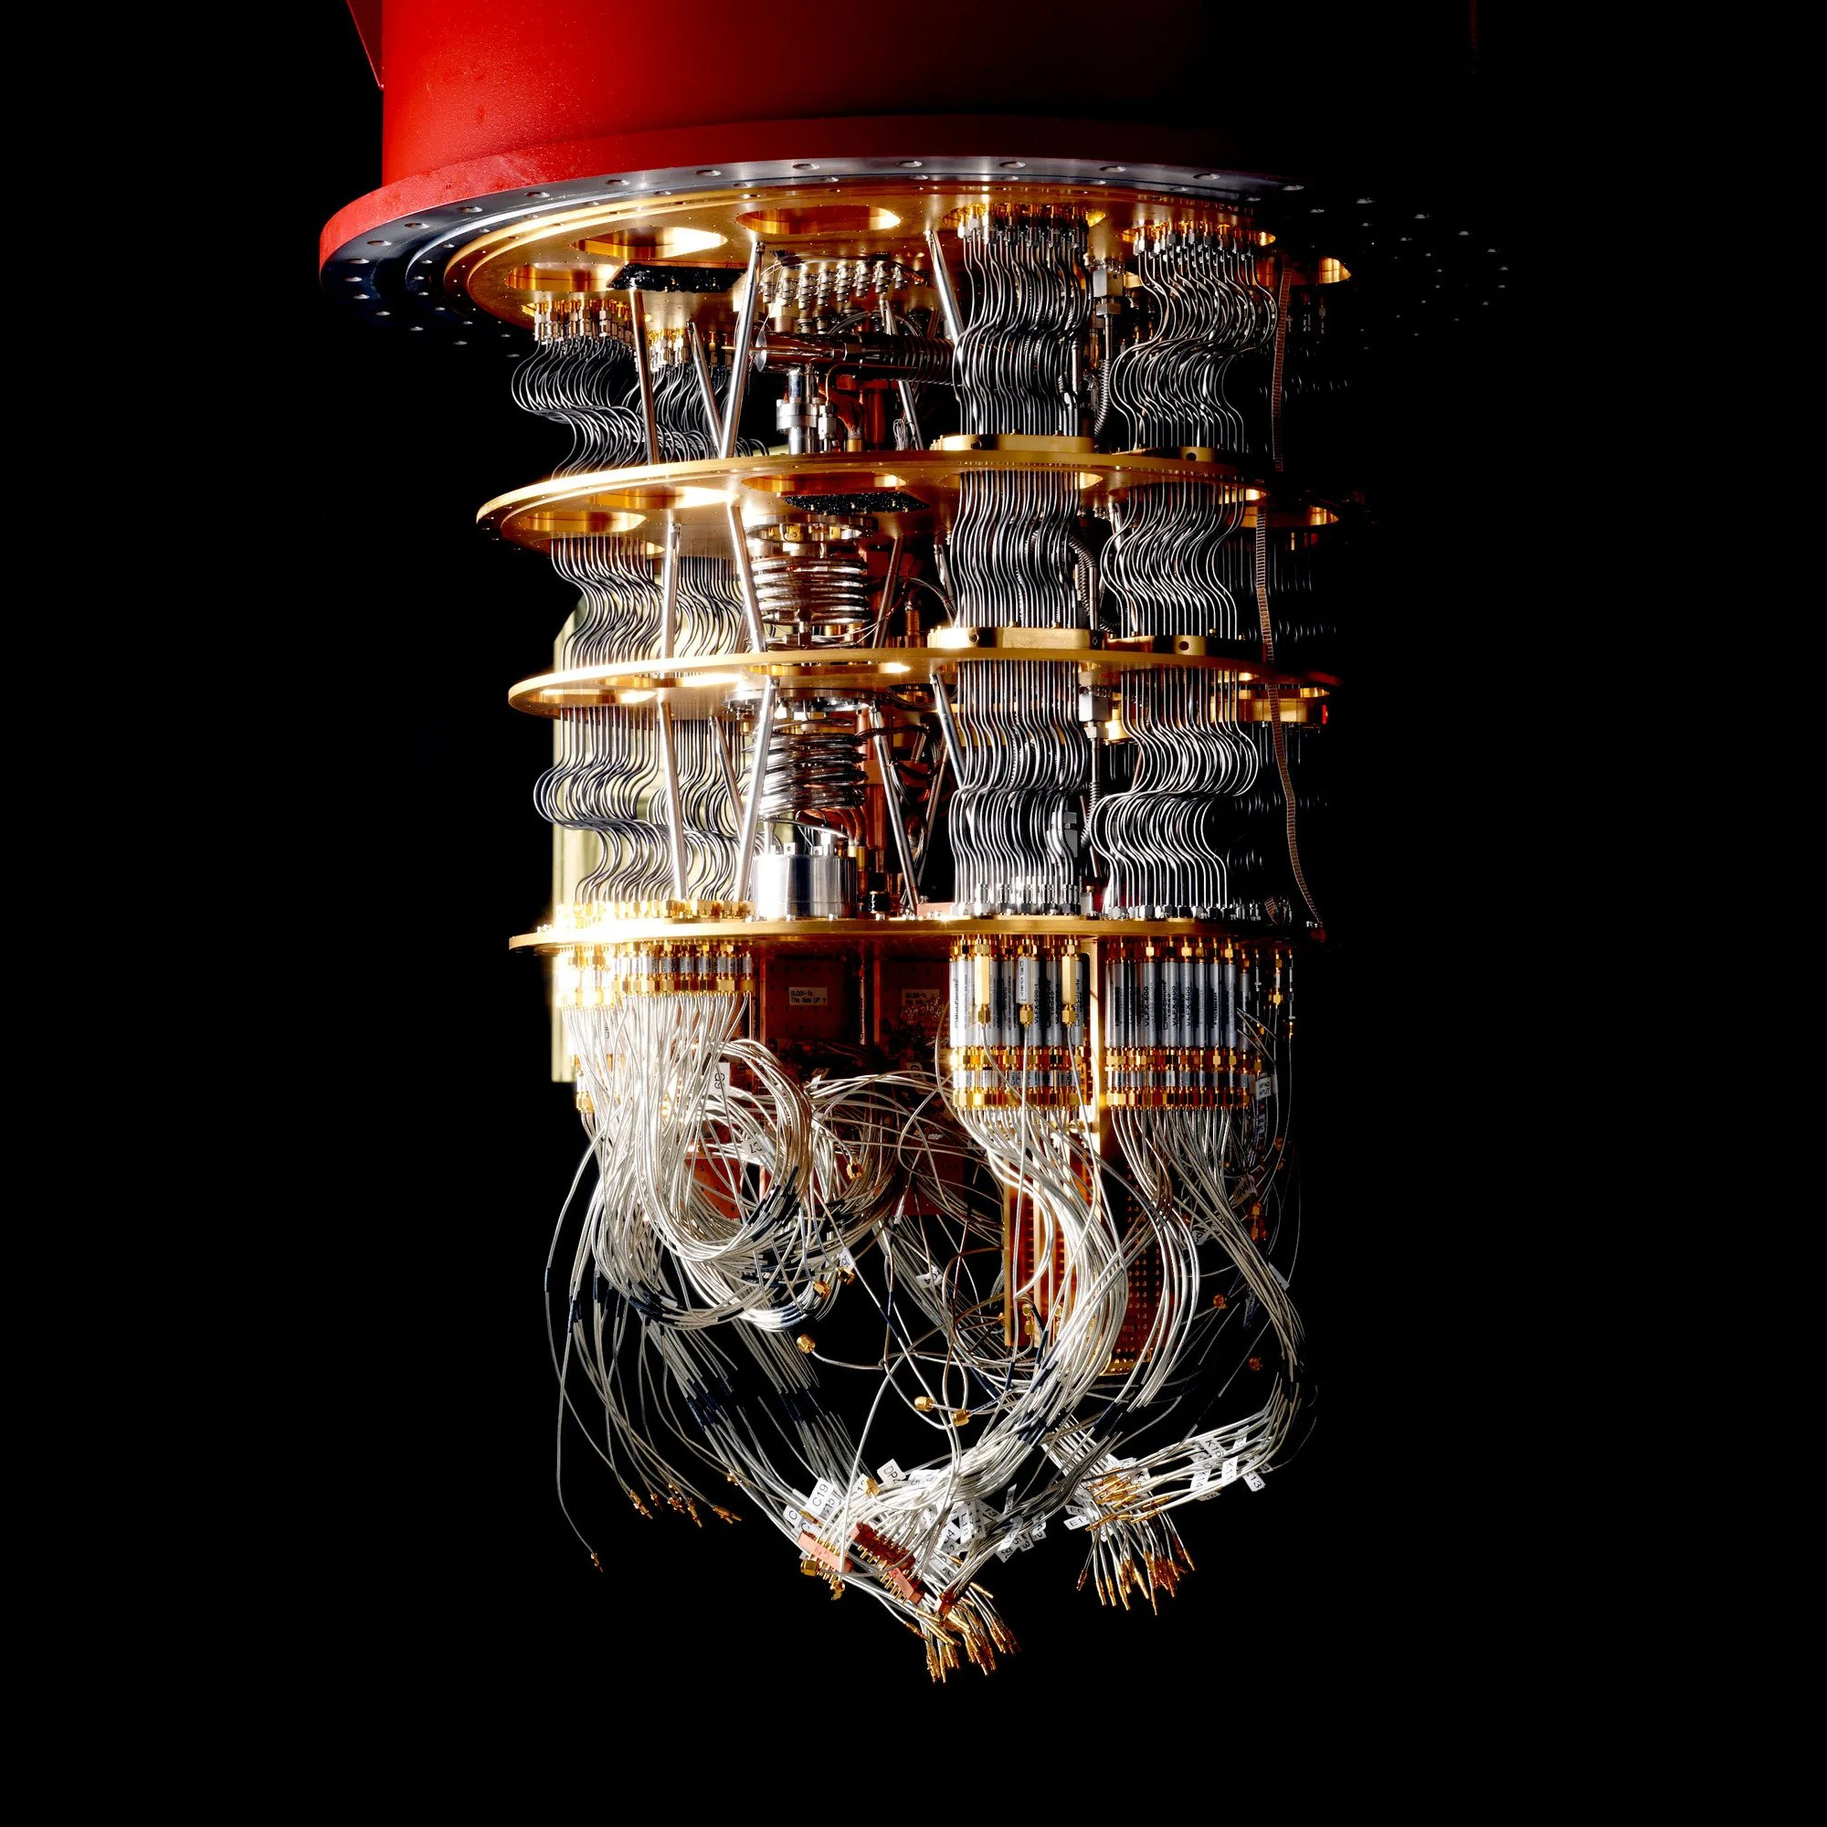
Contact
simone.caldarella@studenti.unitn.it
simone.caldarella98@gmail.com

